Slide 1


Market Sepetim
MARKETSEPETİM

Slide 2
The mobile app helps people to make supermarket shopping with the cheapest cost.

Slide 3
Our Team
Ahmet Hakan Beşel
Cem Yıldız
Software Development
Sales & Marketing
Hüseyin Kerem Mican
Kardelen Ateş
Product Design
Business Development
Kayra Yankı Sirek
Human Resources

Slide 4
Problem
There are so many people that have low-income compared to their expenses. On the other hand, the time spent to earn money is generally higher. By using the app, our customers can reach any product by spending least money in a short period of time.

Slide 5
Solution
We track price of goods and compare those prices. We also pursue the campaigns and discounts for so many shops. By this way, customers can save money and they save time from their shopping.

Slide 6

Market Size
30 Million People
₺591,6
45 Million People
₺49 Billion
Potential customers
Average monthly supermarket spending per person
Whole market
Total market cap

Slide 7
Business Model
In-app ads
Paid Highlight
Subscription
Commission
Ads are one of our main sources of income.
Companies pay a fee to appear at the top.
Users using the app with no ads and special offers.
Companies pay to participate in the system and attract customers.

Slide 8


Competitors
MARKETSEPETİM
 |  | Hesapnet | Deliveri
Trademark | A lot of variety with both online applications and local markets. | Local markets and some online applications are not integrated. | Very few trademarks just because it is in the app store.
Automatic ordering | Possibility of direct automatic ordering with in-app wallet. | Only redirection to the relevant online application. | Limited number of online application redirect.
Earning money | Possibility to earn money by sending chips-receipts. | No idea or anything like that. | Nothing similar about that.

Slide 9

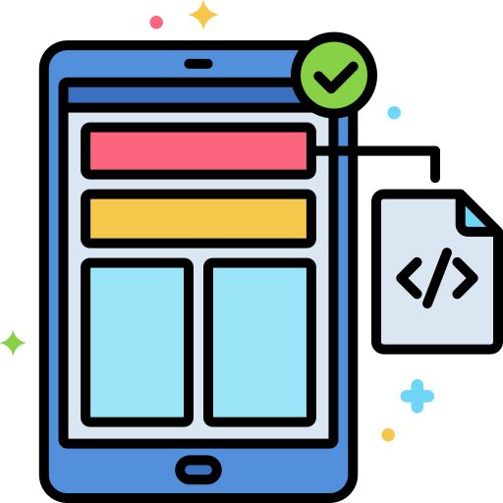

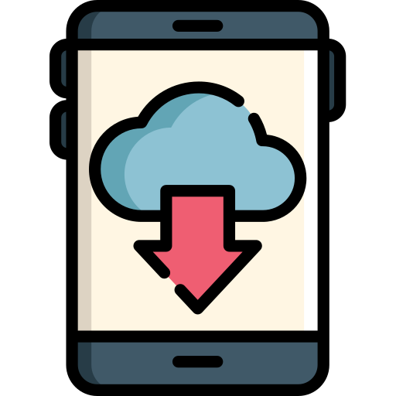

Traction
Now January 2021
June 2020
July 2020
August 2020
December 2021
Prototype
Beta
Published on Play Store and App Store
500K+ App Downloads
10K+ Monthly Subscribers
5 Partnerships
1 Million App Downloads

Slide 10
How Do We Plan To Grow?
01
02
03
Collaboration with influencers
Online ads
Campaigns
By realizing these three plans in future, we will reach more people in 2021.
More and better ads for every platform.
As usual.
In this decade, this is the best way to reach millions of people.

Slide 11
INTELLECTUAL PROPERTY
We have rights to preserve name of our Brand as “ Market Sepetim ”.
Trademark is used for protection of product’s name and logo.
Copyright of the app’s source code artwork and design text will be taken.
Patent will be considered after a groundbreaking update.

Slide 12
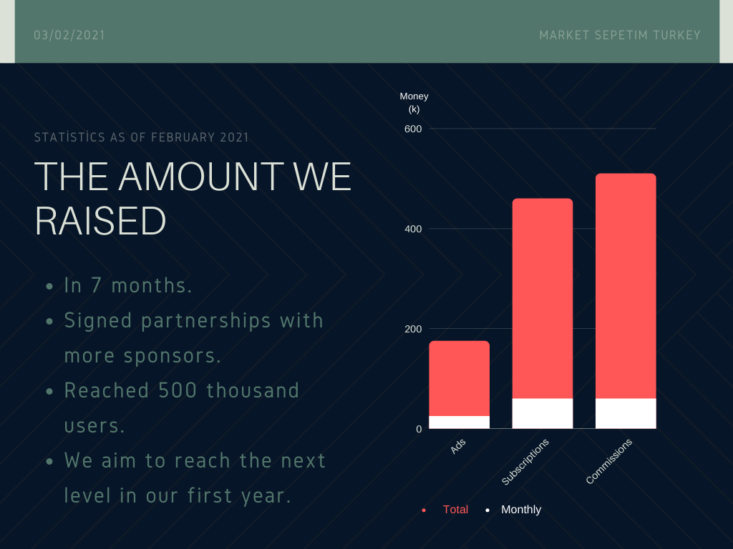
Financials
We raised
₺1.19M
in the half and this is
120%
of what we planned.

Slide 13
Why Should You Invest?
Challenge
Results
Solution
We are planning to reach the whole Market by ease of use and accurate filtering for our app.
One of the most succesfull app at its domain.
Our team is capable of delivirance of such Product.

Slide 14
Thanks!
Ad soyad – bölüm – okul numaraları
Hüseyin Kerem MICAN – Computer Science & Engineering – 150119629
Kardelen ATEŞ – Environmental Engineering – 150216007
Kayra Yankı SIREK –Bioengineering – 150818022
Ahmed Hakan BEŞEL – Computer Science & Engineering – 150119007
Please keep this slide for attribution.

